Slide 1
Semantic Parsing on Freebase from Question-Answer Pairs
Peiqin Gu, Dec 10

Slide 2
Paper Info
Semantic Parsing on Freebase from Question-Answer Pairs, in proceedings of EMNLP, 2013
Author
Jonathan Bernant, Andrew Chou, Roy Frostig, Percy Liang
Affiliate
Stanford University
Comparing paper
Q.Cai and A.Yates (2013). Large-scale semantic parsing via schema matching and lexicon extension. In association for Computational Linguistics (ACL).
Notes:
Freebase is an open knowledge base about all kinds of information, such as music, people, movie, etc. It has been integrated into Google Knowledge Graph to support deeper information retrieval. Up to now, it contains 400 million entities, and over 2 billion facts.

Slide 3
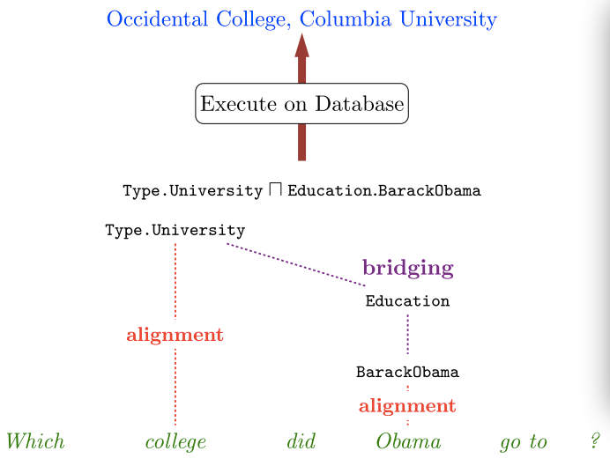
Motivation
Notes:
Given a question saying “which college did Obama go to?”, this system is able to parse the question and map the entities and properties to Freebase lexicon, and get the answer back.

Slide 4
Motivation
This paper focus on the problem of semantic parsing natural language utterances into logical forms that can be executed to produce denotations.
Traditional semantic semantic parsers have two limitations:
They require annotated logical forms as supervision
They operate in limited domains with a small number of logical predicates

Slide 5
Goal of the paper
Learn a semantic parser without annotated logical forms that scales to the large number of predicates on Freebase.
Challenges
At the lexical level, mapping natural language phrases (e.g. “attend”) to logical predicates (e.g. Education)
At the compositional level, a semantic parser must combine the predicates into a coherent logical form

Slide 6
Problem Statement

Slide 7
Problem Statement
Given
(i) a knowledge base K;
And (ii) a training set of question-answer pairs {(x_{i} , y_{i})},
output a semantic parser that maps new questions x to answers y via latent logical forms z and the knowledge base K.
x→y: z

Slide 8
Knowledge base
Let ε denote a set of entities (e.g. BarackObama), and let Ρdenote as set of properties (e.g., placeofBirth). A knowledge base Κ is a set of assertions (e₁, p, e₂) in ε ×Ρ× ε (e.g., BarackObama, placeOfBirth, Honolulu).
Freebase knowledge base (Google, 2013)
41M non-numeric entities
19K properties
596M assertions

Slide 9
Logical forms
To query the knowledge base, they use a logical language called Lambda Dependency-Based Compositional Semantics (λ-DCS).
For the purposes of this paper, they use a restricted subset called simple λ-DCS. It is to produce logical forms that are simpler than lambda calculus forms.

Slide 10
λ-DCS
Each logical form in simple λ-DCS is either a unary (which denotes a subset of ε) or a binary (which denotes a subset of ε×ε). The basic λ-DCS logical forms z and their denotations [[z]]_{K} are defined recursively as follows:
Unary base case
Binary base case
Join
Intersection
Aggregation

Slide 11
λ-DCS
An example
“number of dramas staring Tom Cruise”
Count(Genre.Drama ∧ Performance.Actor.TomCruise)
Conclusion
The knowledge base Κ is a directed graph in which entities are nodes and properties are labels on the edges.
Simple λ-DCS unary logical forms are tree-like graph patterns which pick out a subset of the nodes.

Slide 12
Framework

Slide 13
Framework
Given an utterance x, the semantic parser constructs a distribution over possible derivations D(x). Each derivation d in D(x) is a tree specifying the application of a set of combination rules that culminates in the logical form d.z at the root of the tree.
Composition
Derivations are constructed recursively based on (i) a lexicon mapping natural language phrases to knowledge base predicates; (ii) a small set of composition rules.

Slide 14
Steps
Build a set of derivations for each span of the utterance.
Use the lexicon to generate single-predicate derivations for any matching span (e.g., “born” maps to “PeopleBornHere”).
Given any logical form z₁ that has been constructed over the span [i₁:j₁] and z₂ over a non-overlapping span [i₂:j₂], then generate the following logical forms over the enclosing span [min(i₁, i₂): max(j₁, j₂)]

Slide 15
Modeling
They define a discriminative log-linear model over derivations d in D(x) given utterances x.

Slide 16
Approach

Slide 17
Approach
Freebase has more than 19,000 properties, a major challenge is generating a manageable set of predicates for an utterance.
Two strategies
Alignment: Construct a lexicon that maps natural language phrases to logical predicates by aligning a large text corpus to Freebase.
Bridging: Generate logical predicates compatible with neighboring predicates using the bridging operation.

Slide 18
Alignment
A lexicon L
a mapping from natural language phrases to logical predicates accompanied by a set of features.
Specifically, for a phrase w (e.g., “born in”), L(w) is a set of entries (z, s), where z is a predicate and s is the set of features.
A lexicon is constructed by alignment of a large text corpus to the knowledge base (KB).
Intuitively, a phrase and a predicate align if they co-occur with many of the same entities.

Slide 19
Alignment
Alignment procedure
Construct a set of typed phrases R₁ (e.g. “born in” [Person, Location]) and predicates R₂ (e.g. PlaceOfBirth).
For each r in R₁∨R₂, create its extension F(r), which is a set of co-occurring entity-pairs (e.g., F(“born in”[Person, Location]) = {(BarackObama, Honolulu), …)}.
The lexicon is generated based on the overlap F(r₁)∧F(r₂), for r₁ in R₁ and r₂ in R₂.

Slide 20
Alignment
Typed phrases
15M triples (e₁, r, e₂) (e.g., “Obama”, “was also born in”, “August 1961”) were extracted from ClueWeb09 using the ReVerb open IE system. They downloaded their datasets and heuristically replaced object arguments with KB entities by walking on the Freebase graph from subject KB entities and performing simple string matching.
Lemmatize and normalize each text phrase r in R₁ and augment it with a type signature [t₁, t₂] to deal with polysemy (一词多义). Add an entity pair (e₁, e₂) to the extension of F(r[t₁, t₂]) if the (Freebase) type of e₁(e₂) is t₁(t₂).
From the initial 15M triples, they extracted 55,081 typed binary phrases (9,456 untyped) and 6,299 unary phrases.

Slide 21
Alignment
Logical predicates
Binary logical predicates contain (i) all KB properties; (ii) concatenation of two properties p1.p2 if the intermediate type represents an event (e.g., the married to relation is represented Marriage.Spouse).

Slide 22
Approach
Lexicon construction
Given typed phrases R₁, logical predicates R₂, and their extension F, they can generate the lexicon.
It is useful to think of a bipartite graph with left nodes R₁, and right nodes R₂. Add an edge (r₁, r₂) if:
The type signatures of r₁ and r₂ match and
Their extensions have non-empty overlap (F(r1)∧F(r2)≠NULL).
The final graph contains 109K edges for binary predicates and 294K edges for unary predicates.

Slide 23
Bridging
Bridging
Implicitly expressed predicates, e.g., “What government does Chile have?”, the predicate is expressed by the light verb “have”. “What actors are in Top Gun?”, “What is Italy money?”
In the first example, suppose the phrases “Chile” and “government” are parsed as Chile and Type.FormOfGovernment, and they hypothesize a connecting binary.
Formally, given two unaries z₁ and z₂ with types t₁ and t₂, generate a logical form z₁∧b.z₂ for each binary b whose type signature is (t₁, t₂).

Slide 24
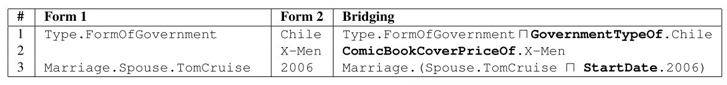
Approach
Bridging
Other examples
“What is the cover price of X-men?”→allow bridging to generate a binary based on a single unary
“Who did Tom Cruise marry in 2006?”→apply bridging to a unary and the intermediate event

Slide 25
Predicate Composition
Rule features
To control the number of applying intersection, join, and bridging operation
Part-of-speech tag features
Introduce features indicating when a word of a given POS tag is skipped
Introduce features on the POS tags involved in a composition
Denotation features

Slide 26
Experiments
Compare the approach to Cai and Yats (2013) and their recently release dataset
Setup
Implement a standard beam-based bottom-up parser which stores the k-best derivations for each span. Use k=500 for all the experiments on FREE917 and k=200 on WEBQUESTIONS.
17 hand-written rules to map question words such as “where” and “how many” to logical forms such as Type.Location and Count.
To compute denotations, they convert a logical form z into a SPARQL query and execute in on Freebase using the Virtuoso engine.

Slide 27
Results
FREE917
Cai and Yates created a dataset consisting of 917 questions involving 635 Freebase relations, annotated with lambda calculus forms. They executed them on Freebase and used the resulting answers to train and evaluate.
To map phrases to Freebase entities, they used the manually-crated entity lexicon used by Cai and Yates, which contains 1,100 entries.
Hold out 30% for the final test, and performed all development on the remaining 70%.
512 examples (80%) for training, 129 (20%) for validation.

Slide 28
Results
The system, trained only on question-answer pairs, obtained 62% accuracy on the test set, outperforming the 59% accuracy reported by Cai and Yates, who trained on full logical forms.

Slide 29
Results
WEBQUESTIONS
Used the Google Suggest API to obtain questions that begin with wh-word and contain exactly one entity. Start with the question “where was Barack Obama born” and performed a breadth-first search over questions (nodes), using the Google Suggest API supplying the edges of the graph.
Amazon Mechanical Turk, 35% random subset of the questions for the final test, and performed all development on the remaining 65% (80% training, 20% validation)

Slide 30
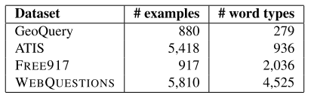
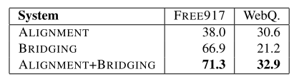
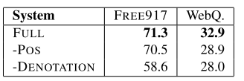
Results

Slide 31
Discussion
Learn models of semantics guided by denotations or interactions with the world.
Connect natural language and open-domain databases. This system reduces the amount of supervision and has a more extensive evaluation on a new dataset.

Slide 32
Inspiration
How to make use of semantic databases and knowledge bases
How to gather data and perform effective evaluation

Slide 33
Thanks for your attention!

